Slide 1
Physics
Module -3
ULTRASONICS
Kiran Madhale
Physics Department
Walchand College of Engineering,Sangli.

Slide 2
Ultrasonics
Introduction to Ultrasonics
Properties of Ultrasonic waves
Ultrasonic Production-
1) Magnetostriction Method 2) Piezo Electric Method
Detection Methods
Applications of Ultrasonics

Slide 3
Introduction
Sound Wave:
Longitudinal wave
Direction of propagation
Direction of oscillation
C
R
Travels : Longitudinal Wave Motion
Form of Energy : Emitted by a vibrating body
Propagation : In all directions

Slide 4
Introduction
Classified of Sound Waves:
Depending upon Frequency they are Divided into 3 groups.
Description
Frequency range Hz
Example
Infrasound
0 - 20
Earth quake
Audible sound
20 – 20,000
Speech, music
Ultrasound
> 20,000 Hz
Bat, Quartz crystal

Slide 5
PROPERTIES OF ULTRASONICS
(1) They have a high frequency i.e high energy i.e small wavelength.
(2) Speed of ultrasonic waves depends on frequency .
(3) For propagation of the ultrasonic waves medium is compulsory
(4) Similar to ordinary sound waves, ultrasonic waves get reflected, refracted, diffracted and absorbed.
(5) They shows negligible diffraction.

Slide 6
ULTRASONICS PRODUCTION
Because of very high frequency,ultrasonic waves can not be produced by usual methods e.g by using loudspeaker connecting to electronic circuit. following are the methods used.
(1) Magnetostriction method.
(2) Piezoelectric method.

Slide 7
Magnetostriction Method
Magnetostriction effect
When a magnetic field is applied parallel to the length of a ferromagnetic rod made of ferromagnetic materials such as iron or nickel, a small change in length occurs.

Slide 8
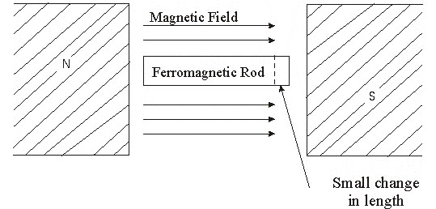
Magnetostriction Method
The change in length (increase or decrease) of ferromagnetic rod is depends upon
i) the strength of the magnetic field,
ii) the nature of the ferromagnetic materials
iii) does not depend of the direction of the field.

Slide 9
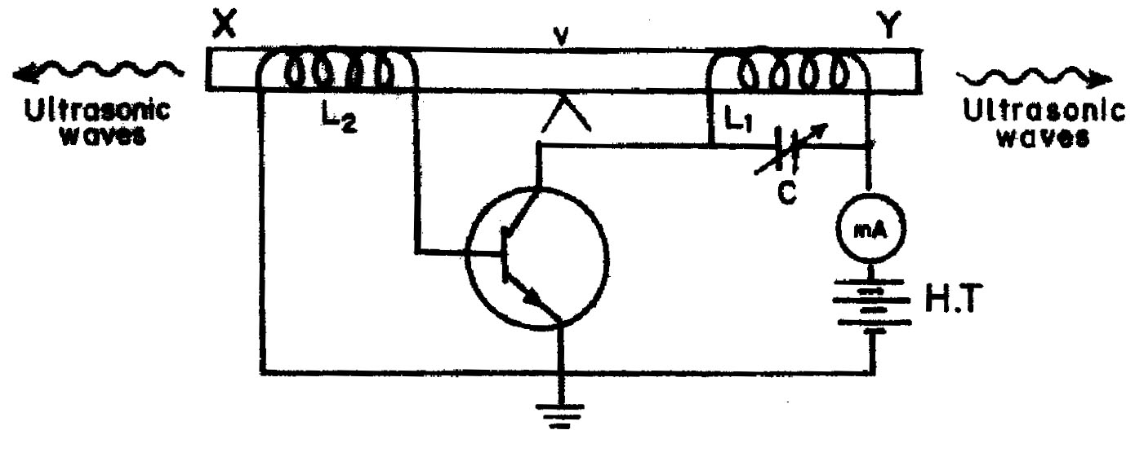
Magnetostriction oscillator
Construction
c
b
e

Slide 10
Magnetostriction oscillator
XY is a rod of ferromagnetic materials like iron or nickel. The rod is clamped in the middle.
The alternating magnetic field is generated by electronic oscillator.
The coil L₁ wound on the right hand portion of the rod along with a variable capacitor C.
This forms the resonant circuit of the collector tuned oscillator. The frequency of oscillator is controlled by the variable capacitor.
The coil L₂ wound on the left hand portion of the rod is connected to the base circuit. The coil L₂ acts as feed –back loop.

Slide 11
Magnetostriction oscillator
Working
When High Tension (H.T) battery is switched on, the collector circuit oscillates with a frequency,
f =
This alternating current flowing through the coil L₁ produces an alternating magnetic field along the length of the rod. The result is that the rod starts vibrating due to magnetostrictive effect.

Slide 12
Magnetostriction Method
The frequency of vibration of the rod is given by
n =
where l = length of the rod
Y = Young’s modulus of the rod material and
ρ =density of rod material
The capacitor C is adjusted so that the frequency of the oscillatory circuit is equal to natural frequency of the rod and thus resonance takes place.
Now the rod vibrates longitudinally with maximum amplitude and generates ultrasonic waves of high frequency from its ends.

Slide 13
Magnetostriction oscillator
Advantages
The design of this oscillator is very simple and its production cost is low
At low ultrasonic frequencies, the large power output can be produced without the risk of damage of the oscillatory circuit.
Disadvantages
It has low upper frequency limit and cannot generate ultrasonic frequency above 300 kHz
The frequency of oscillations depends on temperature.
There will be losses of energy due to hysteresis and eddy current.
Hence instead of rod bundle of wires of ferromagnetic materials are used

Slide 14
PIEZO ELECTRIC Method
Principle : Piezo electric effect
If mechanical pressure is applied to one pair of opposite faces of certain crystals like quartz, equal and opposite electrical charges appear across its other faces. This is called as piezo-electric effect.
The converse of piezo electric effect is also true.
If an electric field is applied to one pair of faces, the corresponding changes in the dimensions of the other pair of faces of the crystal are produced. This is known as inverse piezo electric effect or electrostriction
Best example of piezoelectric effect is “Gas lighter”

Slide 15
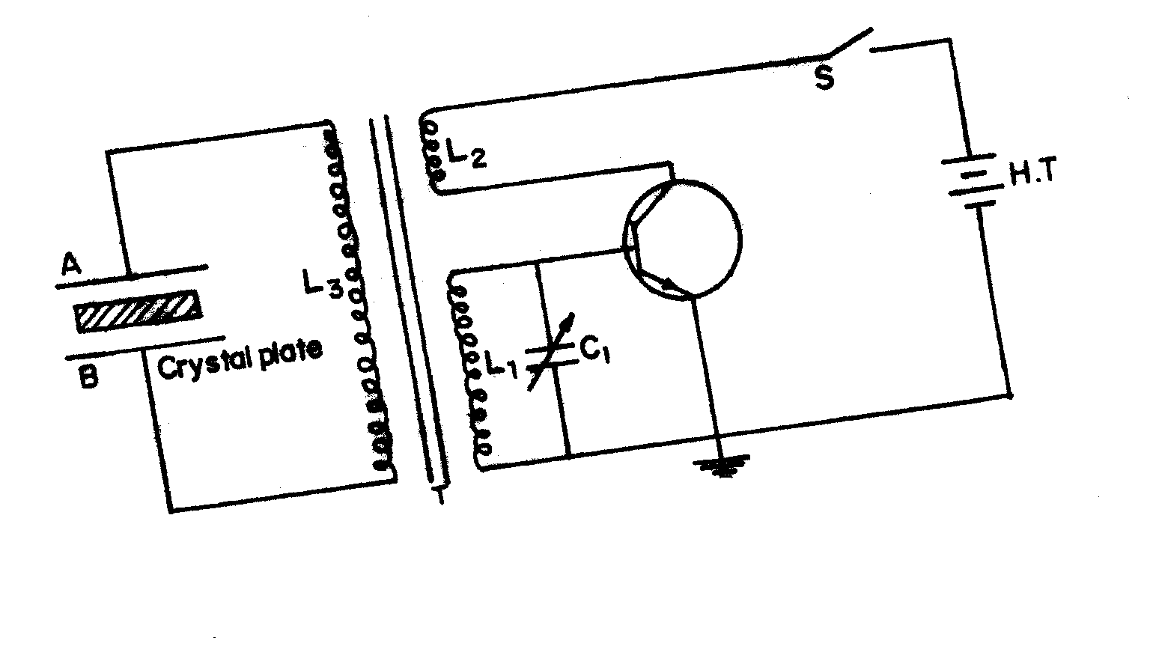
PIEZO ELECTRIC oscillator
The circuit diagram is shown in Figure
Piezo electric oscillator

Slide 16
PIEZO ELECTRIC oscillator
The quartz crystal is placed between two metal plates A and B.
The plates are connected to the primary (L₃) of a transformer which is inductively coupled to the electronics oscillator.
The electronic oscillator circuit is a base tuned oscillator circuit.
The coils L₁ and L₂ of oscillator circuit are taken from the secondary of a transformer T.
The collector coil L₂ is inductively coupled to base coil L₁.
The coil L₁ and variable capacitor C₁ form the tank circuit of the oscillator.

Slide 17
PIEZO ELECTRIC oscillator
Working
When H.T. battery is switched on, the oscillator produces high frequency alternating voltages with a frequency.
Due to the transformer action, an oscillatory e.m.f. is induced in the coil L₃. This high frequency alternating voltages are fed on the plates A and B.
Inverse piezo-electric effect takes place and the crystal contracts and expands alternatively. The crystal is set into mechanical vibrations.
The frequency of the vibration is given by
n =
where P = 1,2,3,4 … etc. for fundamental, first over tone, second over tone etc.,
Y = Young’s modulus of the crystal and
ρ = density of the crystal.

Slide 18
PIEZO ELECTRIC oscillator
Advantages
Ultrasonic frequencies as high as 500 MHz can be obtained.
The output of this oscillator is very high.
It is not affected by temperature and humidity.
Disadvantages
The cost of piezo electric quartz is very high
The cutting and shaping of quartz crystal are very complex.

Slide 19
Applications of Ultrasonic waves
(1)Detection of flaws in metals
Principle:
Ultrasonic waves are used to detect the presence of flaws or defects in the form of cracks, cavity, porosity etc., in the internal structure of a material
By sending out ultrasonic beam and by measuring the time interval of the reflected beam, flaws in the metal block can be determined.

Slide 20
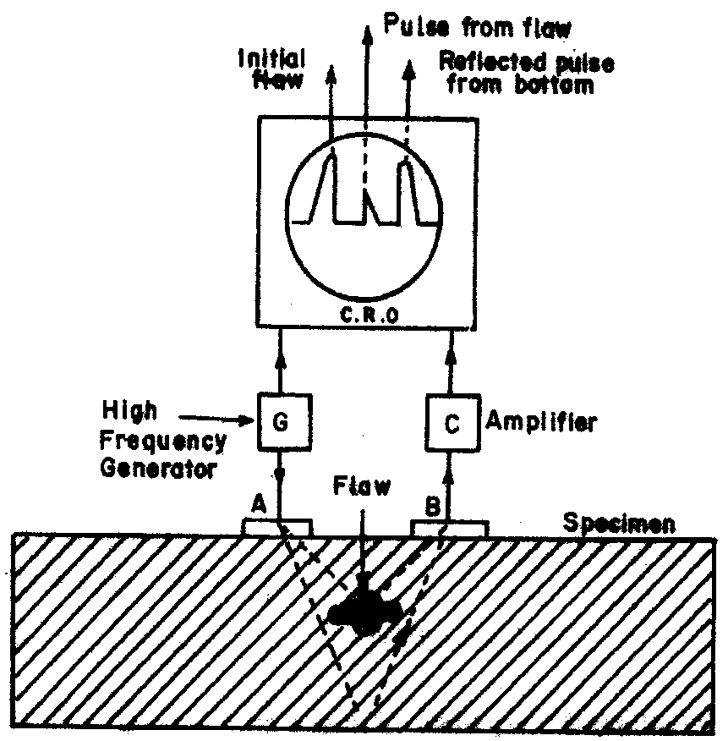
Detection of flaws in metals
Experimental setup
It consists of an ultrasonic frequency generator and a cathode ray oscilloscope (CRO),transmitting transducer(A), receiving transducer(B) and an amplifier.

Slide 21
Detection of flaws in metals
Working
In flaws, there is a change of medium and this produces reflection of ultrasonic at the cavities or cracks.
The reflected beam (echoes) is recorded by using cathode ray oscilloscope.
The time interval between initial and flaw echoes depends on the range of flaw.
By examining echoes on CRO, flaws can be detected and their sizes can be estimated.

Slide 22
Features
This method is used to detect flaws in all common structural metals and other materials like rubber tyres etc.
The method is very cheap and of high speed of operation.
It is more accurate than radiography.

Slide 23
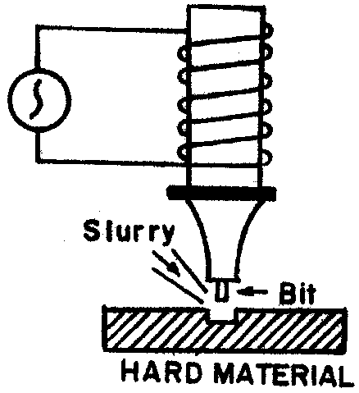
Ultrasonic Drilling
Ultrasonics are used for making holes in very hard materials like glass, diamond etc.
For this purpose, a suitable drilling tool bit is fixed at the end of a powerful ultrasonic generator.
Some slurry (a thin paste of carborundum powder and water) is made to flow between the bit and the plate in which the hole is to be made
Ultrasonic generator causes the tool bit to move up and down very quickly and the slurry particles below the bit just remove some material from the plate.
This process continues and a hole is drilled in the plate.

Slide 24
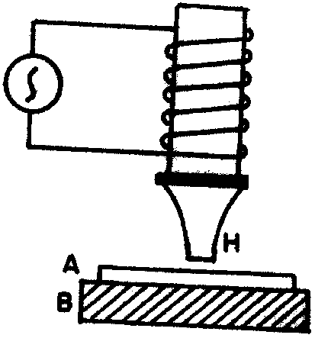
Ultrasonic welding
The properties of some metals change on heating and therefore, such metals cannot be welded by electric or gas welding.
In such cases, the metallic sheets are welded together at room temperature by using ultrasonic waves.
For this purpose, a hammer H is attached to a powerful ultrasonic generator as shown in Figure
The metallic sheets to be welded are put together under the tip of hammer H.
The hammer is made to vibrate ultrasonically. As a result, it presses the two metal sheets very rapidly and the molecules of one metal diffuse into the molecules of the other.
Thus, the two sheets get welded without heating. This process is known as cold welding.

Slide 25
SONAR
SONAR is a technique which stands for Sound Navigation and Ranging.
It uses ultrasonics for the detection and identification of underwater objects.
The method consists of sending a powerful beam of ultrasonics in the suspected direction in water.
By noting the time interval between the emission and receipt of beam after reflection, the distance of the object can be easily calculated.
The change in frequency of the echo signal due to the Dopper effect helps to determine the velocity of the body and its direction.
Measuring the time interval (t) between the transmitted pulses and the received pulse, the distance d = vt/2 between the transmitter and the remote object is determined using the formula., where v is the velocity of sound in sea water.
The same principle is used to find the depth of the sea.
Applications of SONAR
Sonar is used in the location of shipwrecks and submarines on the bottom of the sea.
It is used for fish-finding application.
It is used for seismic survey

Slide 26
Note of Acoustical grating has been given in class then also will be given later.
Assignment will be given very soon.
Thank you very much

